Slide 1


Introduction to Internet and Web Development
By: Aditya Raj Singh ⚡

Slide 2



Speaker
Aditya Raj Singh
Full Stack Developer || Tech Enthusiast || Mentor @Codeasylums
@adi4adityaraj @AdityRajSingh

Slide 3
What is Internet?

Slide 4
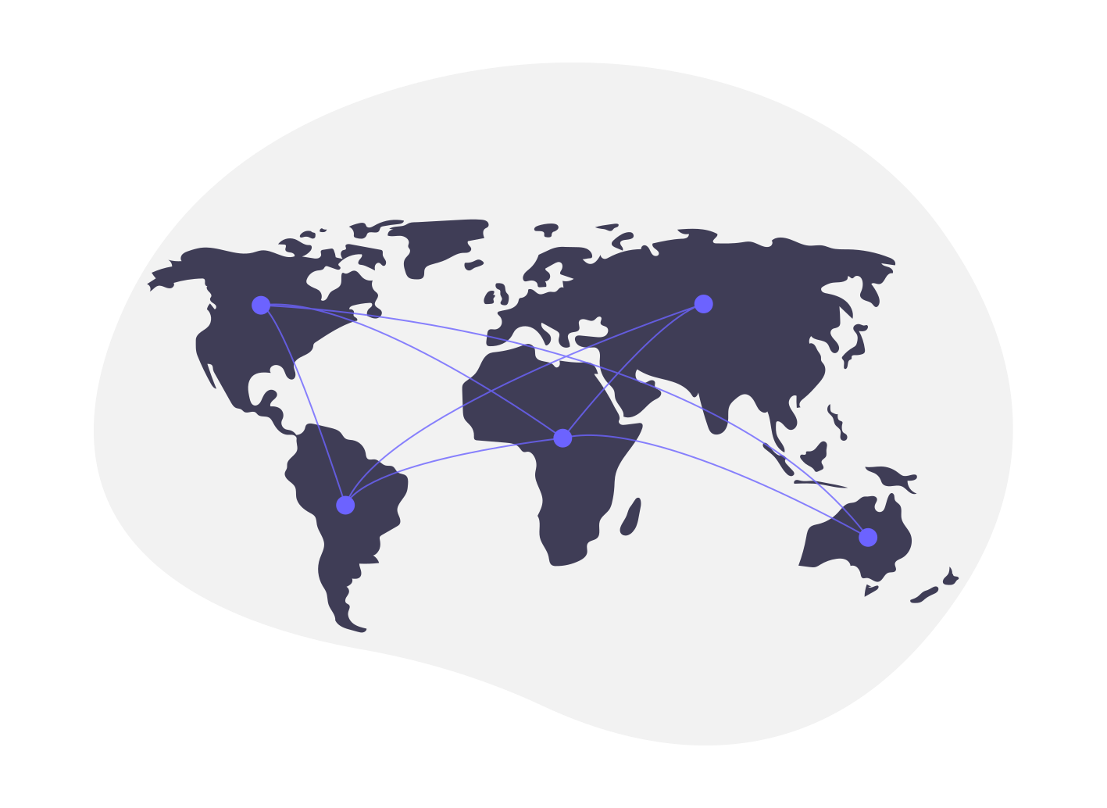
⚡The Internet is generally defined as a global network connecting millions of computers. ⚡ Unlike online services, which are centrally controlled, by design, the Internet is decentralized.
⚡No single person or organization controls the Internet in its entirety.
⚡In order to connect to the Internet, you must have access to an Internet service provider (ISP), which acts the middleman between you and the Internet
BACK END
TEXT
Front-End Developer

Slide 5
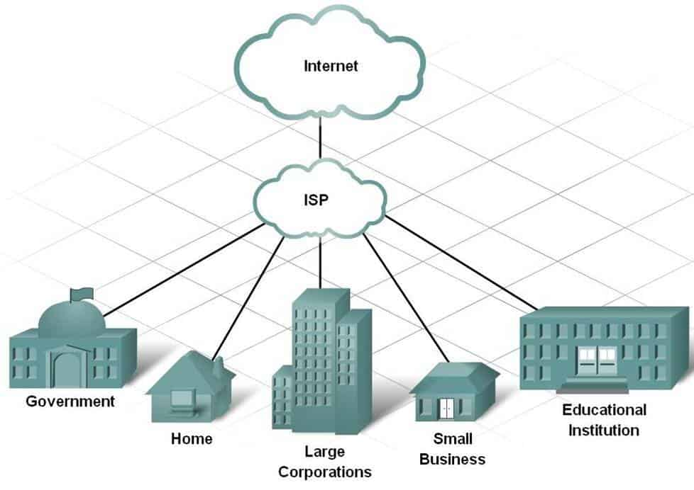
What is a Internet Service Provider?
⚡An Internet service provider (ISP) is a company that provides customers with Internet access.
⚡Data may be transmitted using several technologies, including dial-up, cable modem, wireless or dedicated high-speed interconnects.
⚡Examples: Jio, Airtel, Vodafone, Idea, BSNL, etc
BACK END
TEXT
Front-End Developer

Slide 6
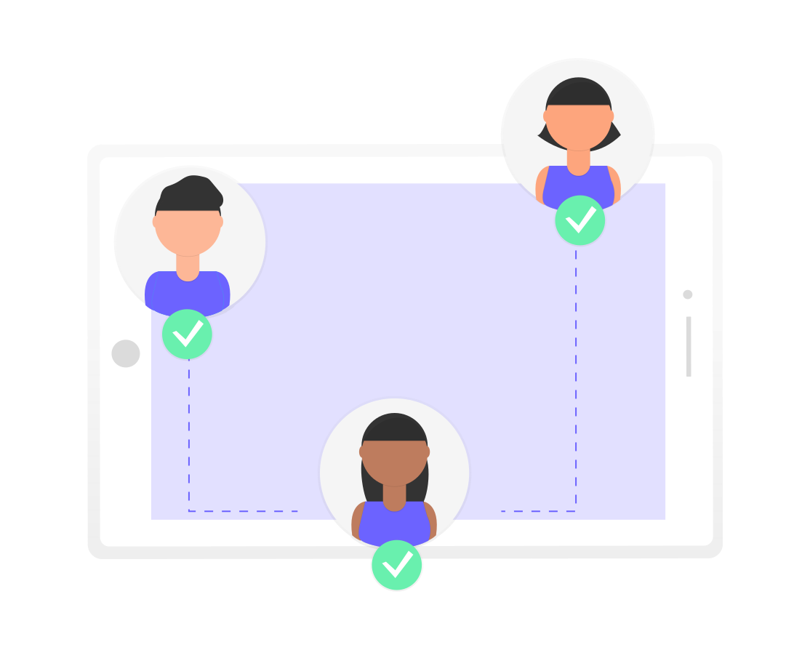
How Internet works?
⚡All computers on the Internet communicate with one another using the Transmission Control Protocol/Internet Protocol suite, abbreviated to TCP/IP.
⚡A protocol is a set of rules specifying how computers should communicate with each other over a network
BACK END
TEXT
Front-End Developer

Slide 7
No. of Internet Users?

Slide 8
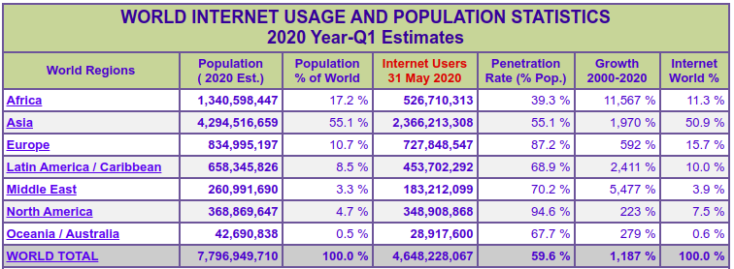
Some Statistics!

Slide 9

What is a Client and a Server?
⚡Clients and servers are both applications that communicate over the Internet
⚡ Clients are “closer to the user” in that they are more user-facing applications like web browsers, email clients, or smartphone apps
⚡Servers are applications running on a remote computer which the client communicates over the Internet when it needs to.

Slide 10
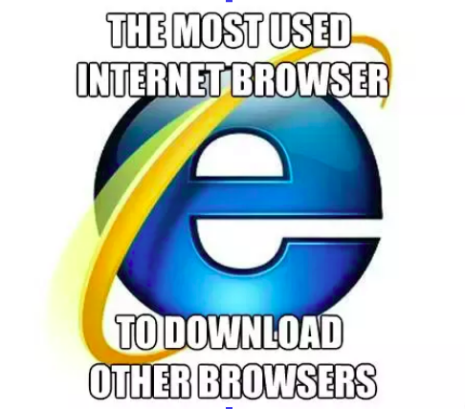
What is a web browser?

Slide 11
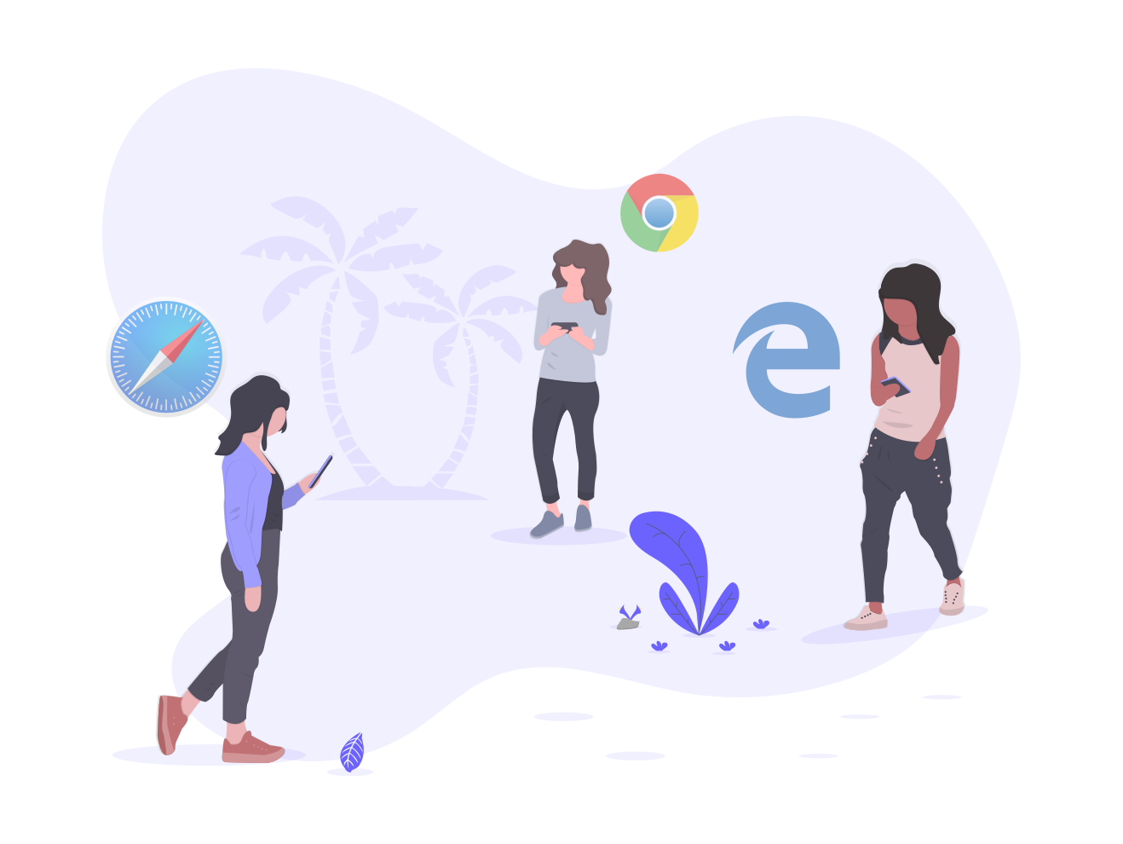
What is a Web Browser?
⚡A Web browser contains the basic software you need in order to
Find
Retrieve
View & Send
information over the Internet.
⚡This include softwares that let you
Send and receive email
Read messages from newsgroups
Browse the World Wide Web (or Web)
BACK END
TEXT
Front-End Developer

Slide 12
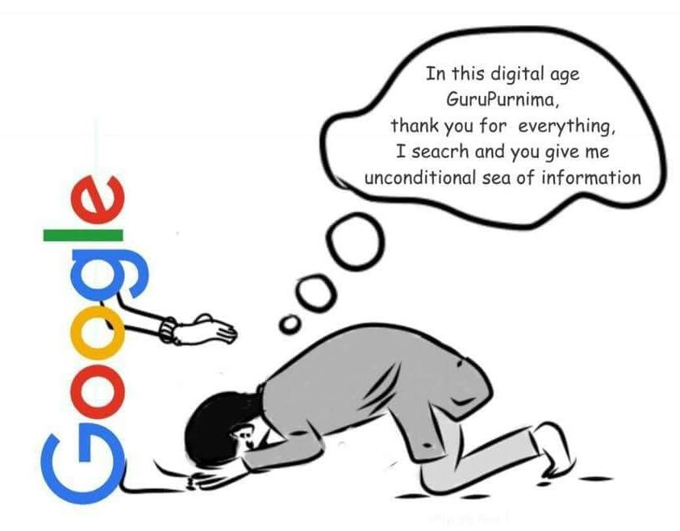
Do you know how to Google?

Slide 13
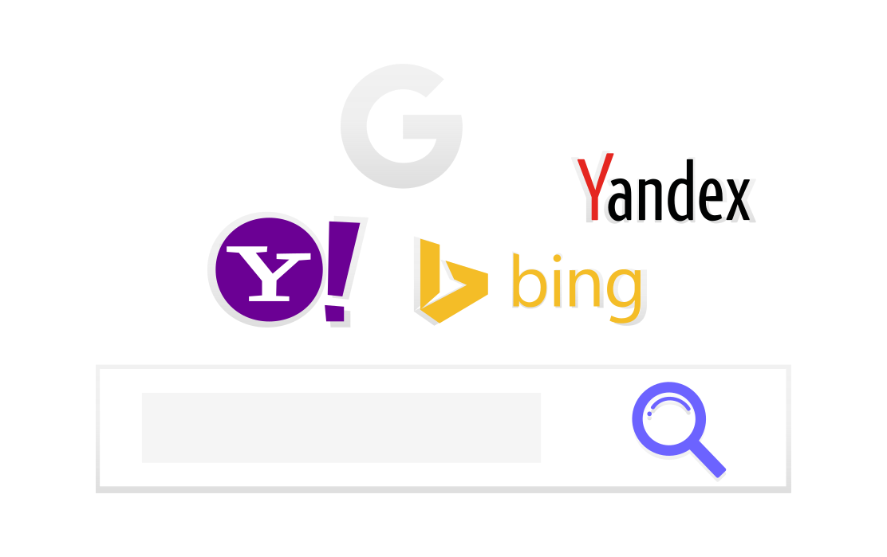
How to Google?
⚡Keep it simple
⚡Use words that websites use aka Keywords
⚡Perform an Advanced Google Image Search
⚡Source: StackOverflow, Github, Documentation
⚡Use ‘vs’ for differences

Slide 14
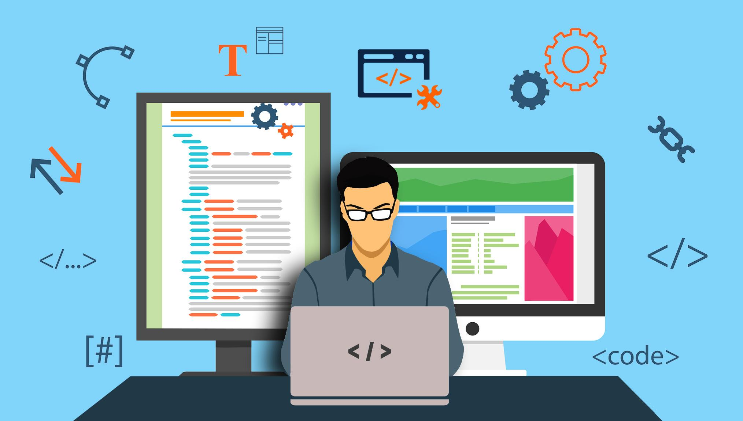
Introduction to Web Development
By: Abhishek Mankuskar ⚡

Slide 15

Speaker
Abhishek Mankuskar
Web Developer || Open-Source Mentor at Student Code-in

Slide 16
01.
What is Web Development ?

Slide 17

Web development usually refers to the activities related to
websites functionalities development.
⚡ Frontend Developer
⚡ Backend Developer
⚡ Database

Slide 18
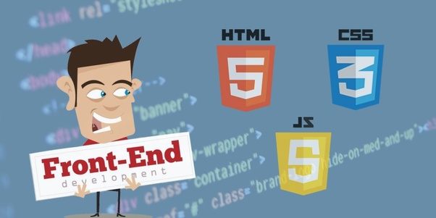
Designing Web Page
Performs Client Side Programming
Responsive Web Page
Html, Css, JS
⚡Frontend Developer

Slide 19

Server side Logic
Manage the Database
Design API’s
Python, Ruby, Java, PHP, Node. Js
⚡Backend Developer

Slide 20

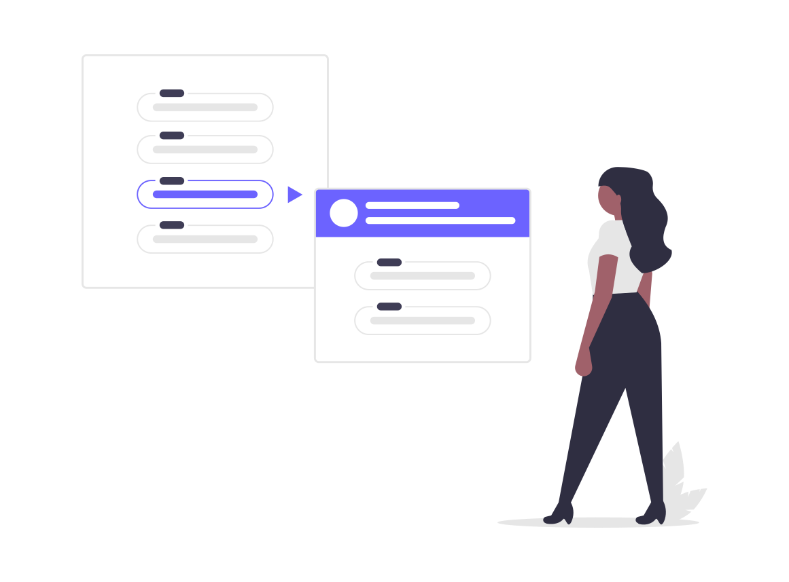
Components of Web Development
Web Development

Slide 21
02.
How Browser Interacts With Server ?

Slide 22
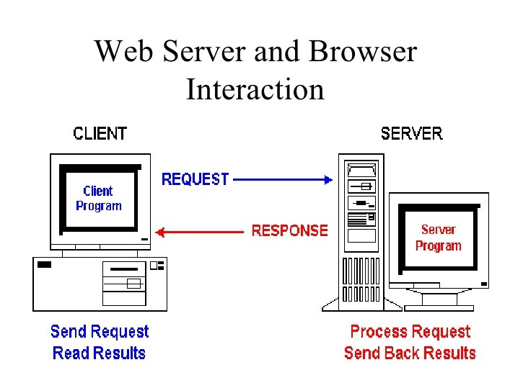
How Web Browser Interacts with the Web Server And Show Us the Web page We Searched for
Step 1 : User Search for the web page in browser.
Step 2 : DNS Sends the IP Address of the web page to the browser.
Step 3 : Browser Makes the TCP Connection with Server.
Step 4 : Browser Send the request to the Server for the Web page using HTTP Protocol.
Step 5 : Server searches the web page on its Hard Disk with the help of OS and sends the searched result to the Web Browser Using HTTP Protocol.

Slide 23
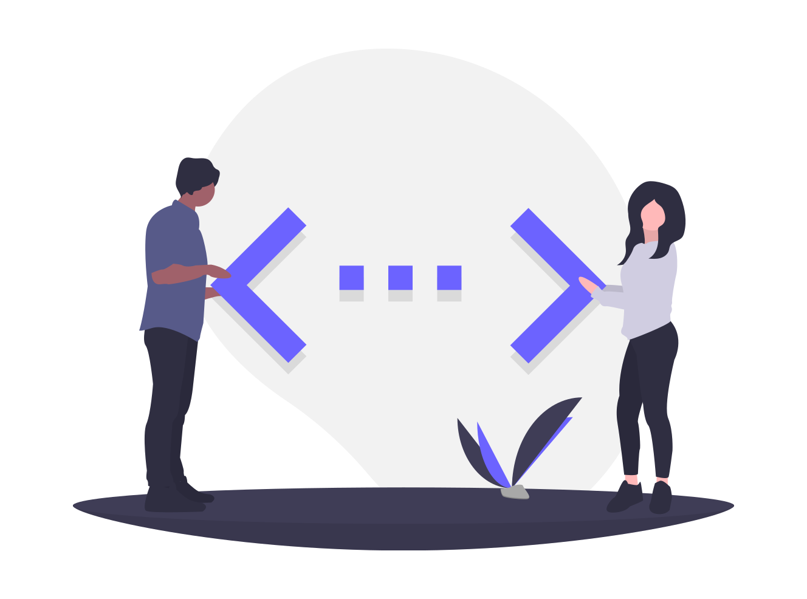
Understanding Different Platforms
⚡ Personal Computers ⚡ Laptop Workstation ⚡ Smartphones ⚡ Tablets and Personalized Devices ⚡ Responsive and User-First Designs
BACK END
TEXT
Front-End Developer

Slide 24
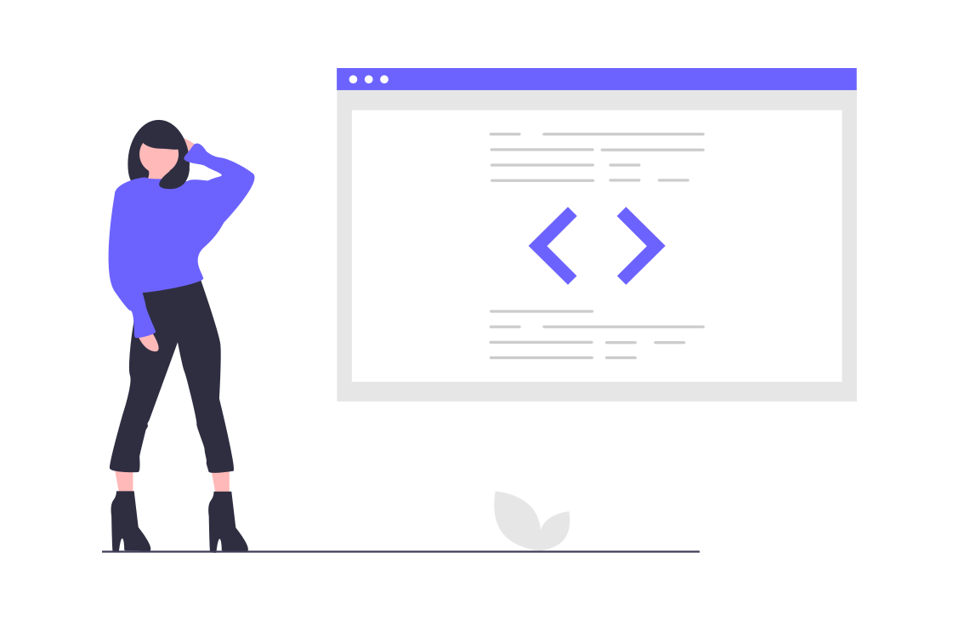
Introduction to Frontend Development
By: Harsh Mishra ⚡

Slide 25
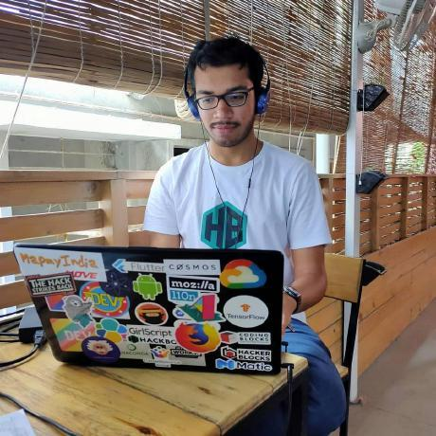
Speaker
Harsh Mishra
Full Stack Developer || GeeksForGeeks Intern || Open-Source Mentor

Slide 26
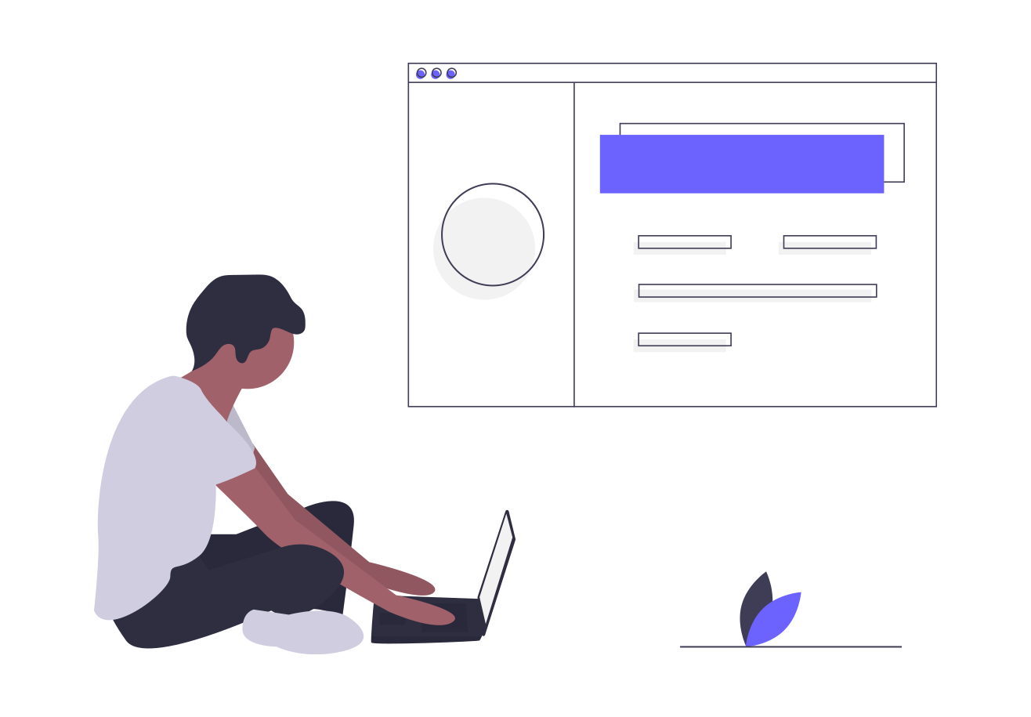
What exactly means to be a “Frontend” ?
FRONT END
BACK END
TEXT
Front-End Designer
Front-End Developer

Slide 27

It’s Tricky!
⚡ Bridge between Visual Designers and Backend Developers ⚡ Changing Front-End Paradigms with rise of Libraries and Frameworks ⚡ Performance and Quality Assurance is still an Issue. ⚡ Cross-Browser Compatibility is difficult.
BACK END
TEXT
Front-End Developer

Slide 28
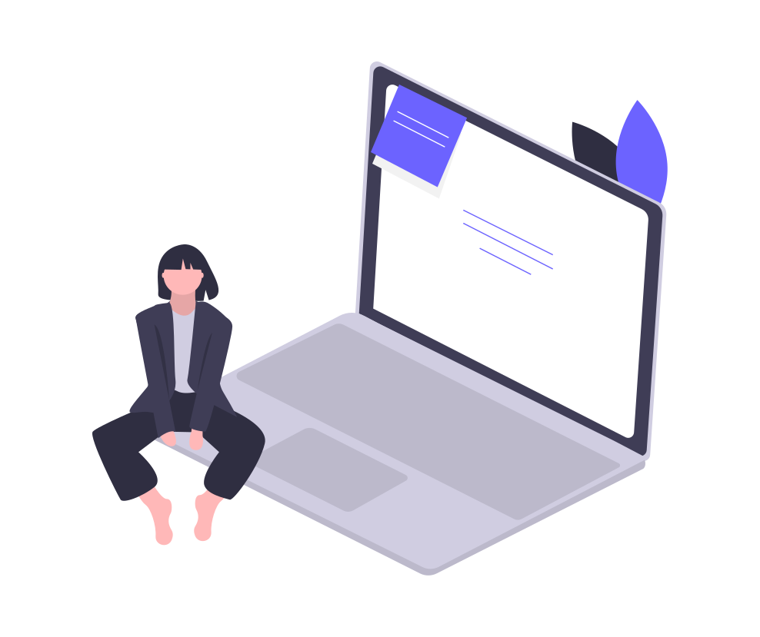
Why should you learn Front-End Development?
⚡ Most Profitable Skill-Set in the Market. ⚡ Opportunities for Freelancing and Development. ⚡ Soaring Rise in Frameworks and Libraries makes the Job Easy. ⚡ Flexibility in Development
BACK END
TEXT
Front-End Developer

Slide 29
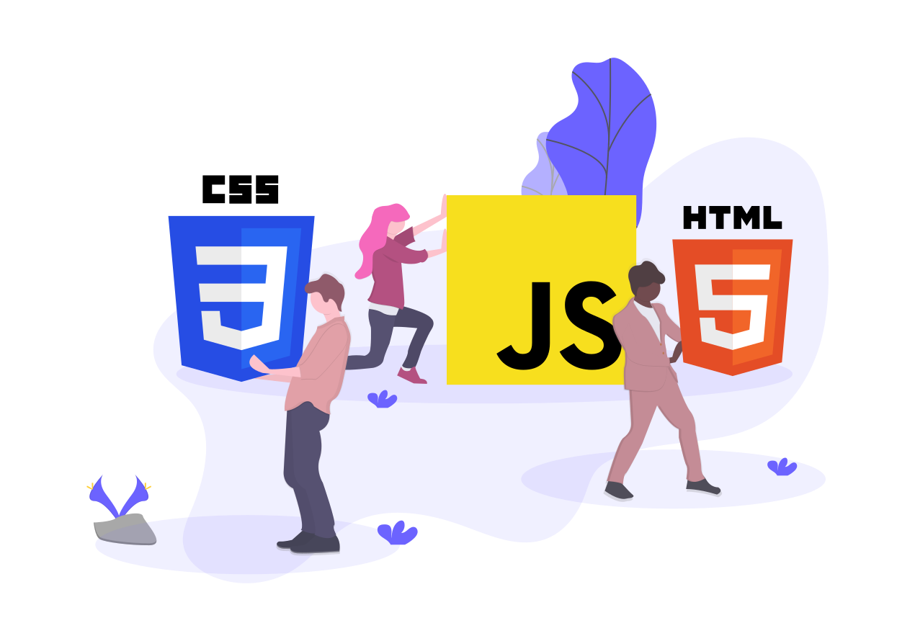
Getting Started with the Basics

Slide 30
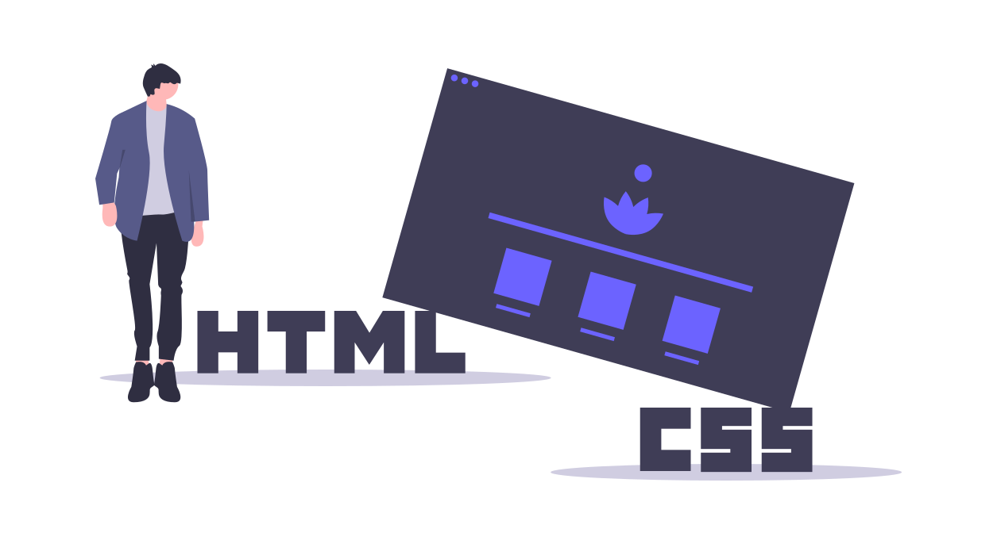
What you should know about HTML & CSS?
⚡ Making basic HTML Structures. ⚡ Adding Links, Pictures and Videos. Making Tables and Layouts. ⚡ Making use of CSS Selectors to add Design. ⚡ Make use of Properties and Values in CSS to define the User-Interface.

Slide 31
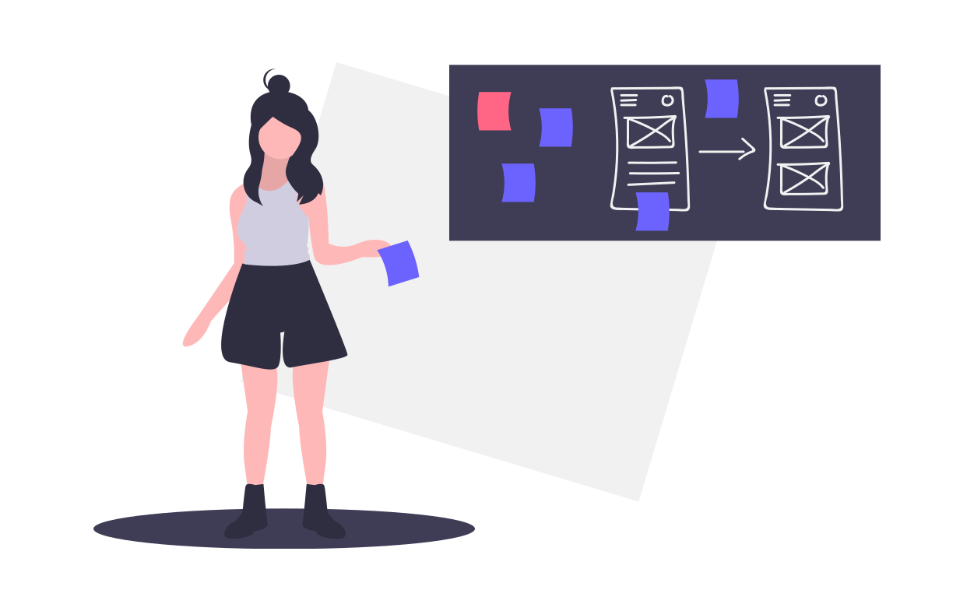
Designing the User-Interface
⚡ Understand the User-Interaction with your Website. ⚡ Design Responsive Web Design Components. ⚡ Prototype your Development before starting up. ⚡ Make use of Adobe XD / Figma to rapidly prototype. ⚡ Bridge the Human Understanding with the Interface.

Slide 32
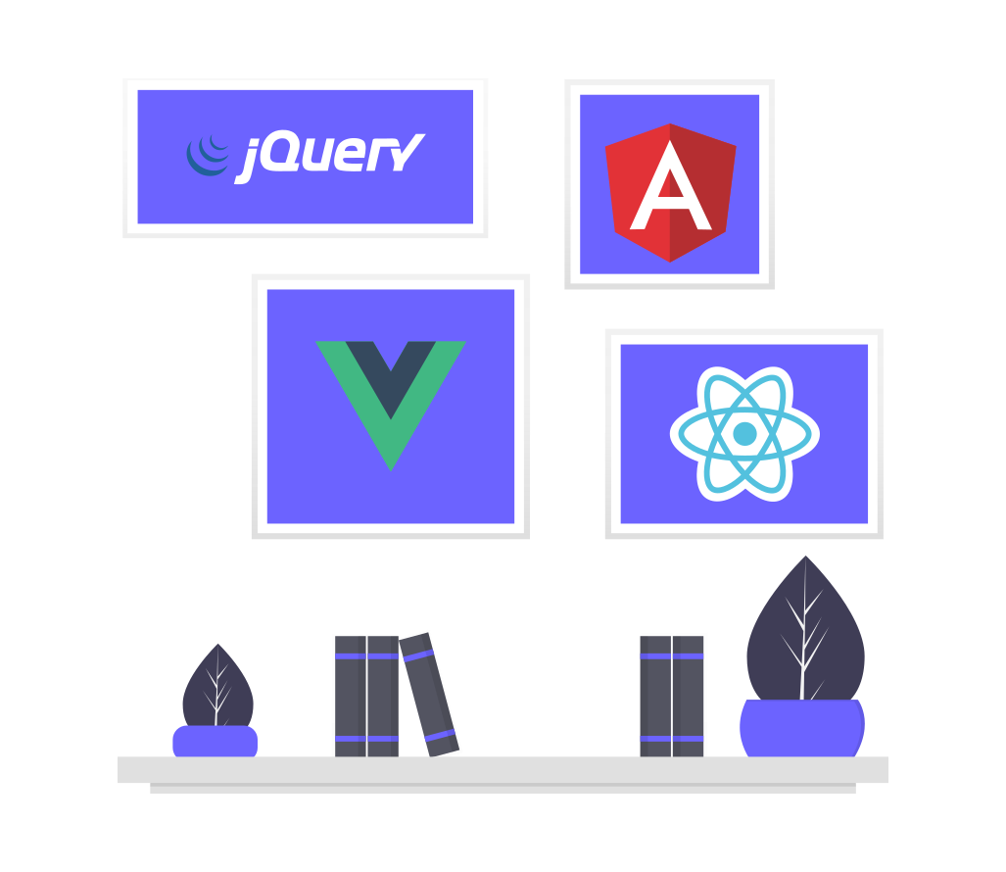
Enter the JavaScript Cosmos
⚡ Start with basics of JavaScript and understanding the Syntax. ⚡ Research on DOM Extensively and make Vanilla JavaScript Projects. ⚡ Add JS Functionality to your HTML-CSS Projects. ⚡ Learn a JS Library like React or JQuery to develop fast. ⚡ Bank on Frameworks like Angular to develop Architecture as a Code.

Slide 33
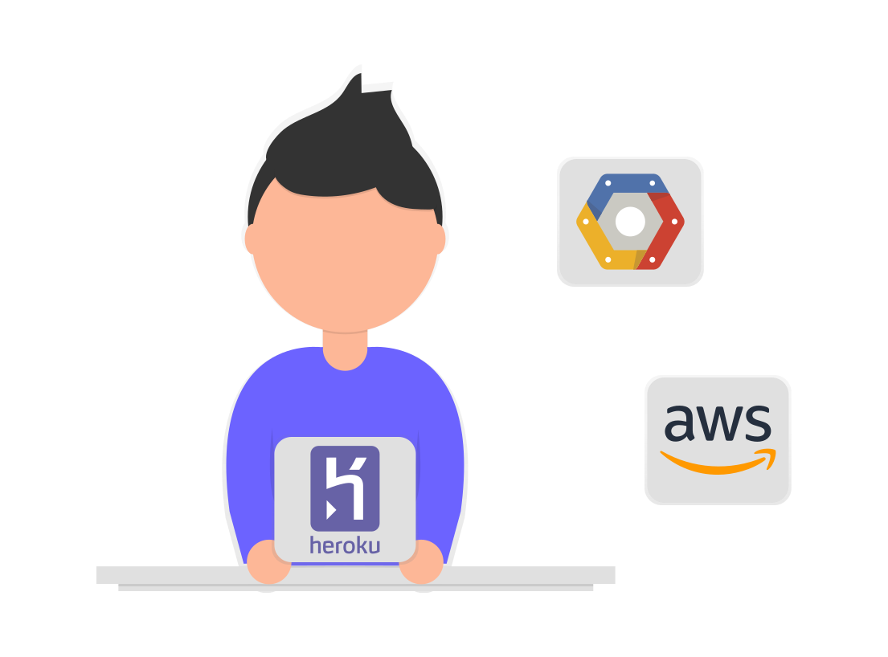
Deployment on Cloud
⚡ Learnt Git (Version Control System) and Github. ⚡ Learn Deployment Services like Heroku and Netlify. ⚡ Learn SSH and Terminal. ⚡ Learn Cloud Services like AWS & Azure to deploy Services.

Slide 34
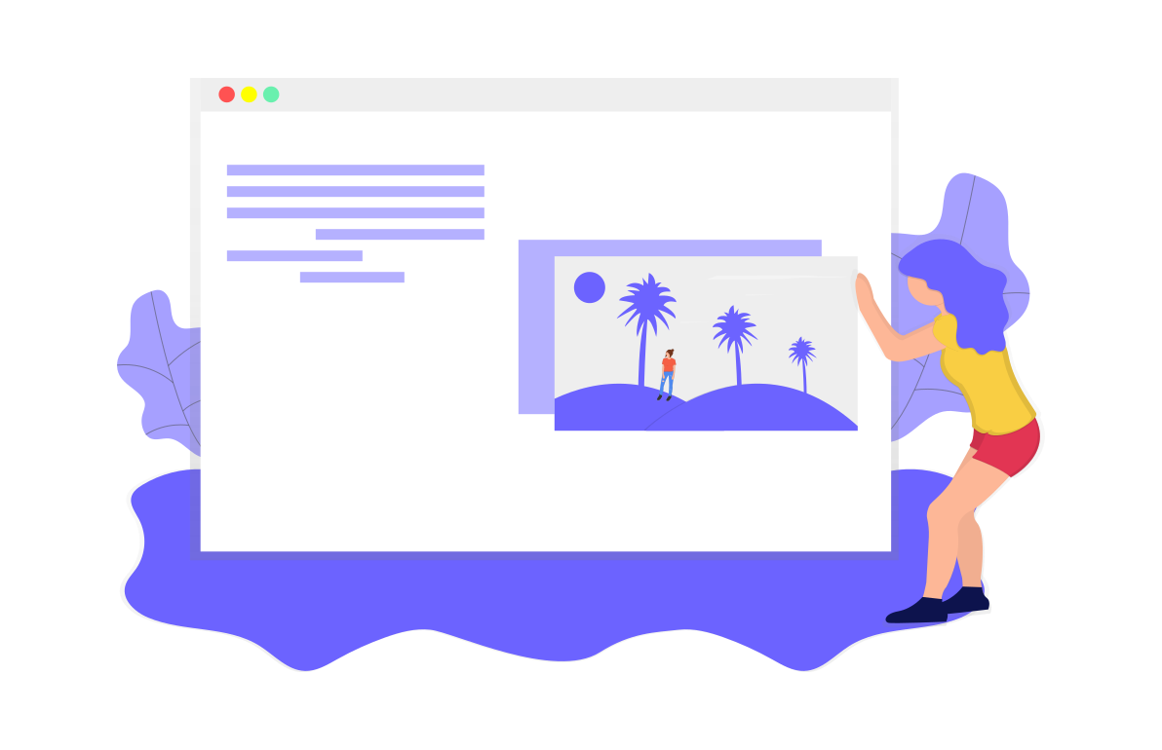
What exactly makes you a Front-End Dev?
⚡ Creating Immersive User-Interface
⚡ Understand User-Flow on your Interface
⚡ Add Functionality to the Interface
⚡ Provide compatibility with Backend APIs
⚡ Understand Dynamics of Development

Slide 35
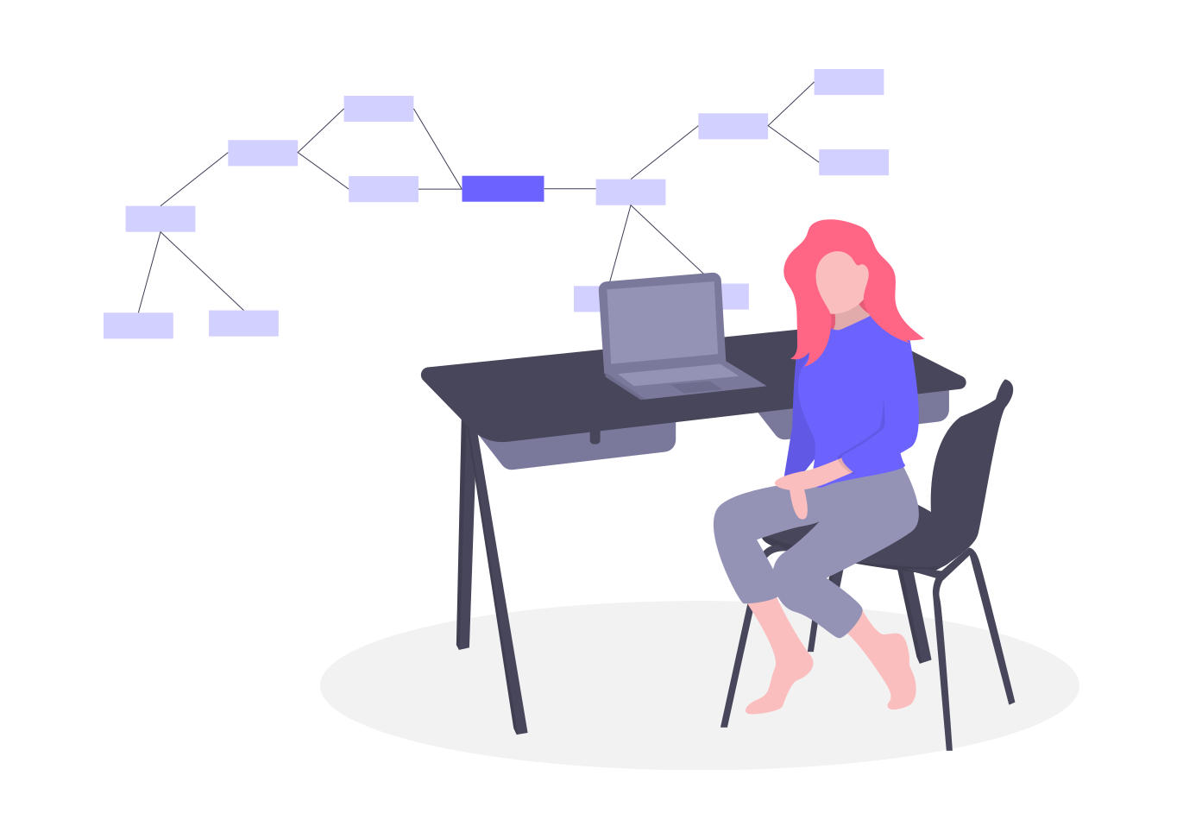
Should I straight get into Frameworks and Libraries?

Slide 36

Endpoint

